Slide 1
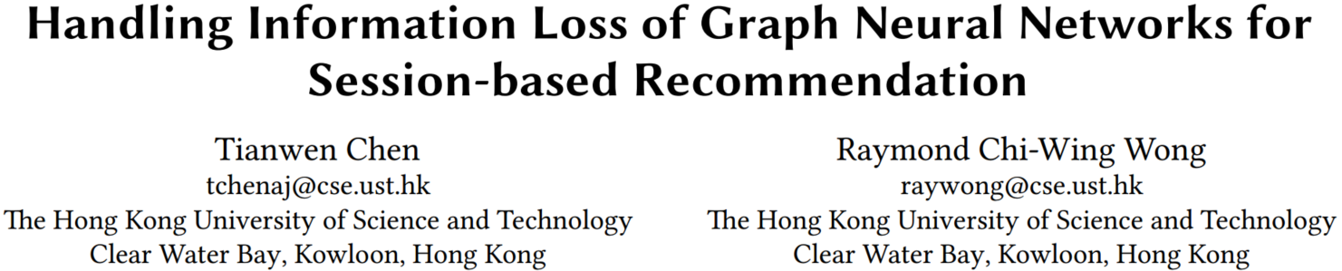

Slide 2
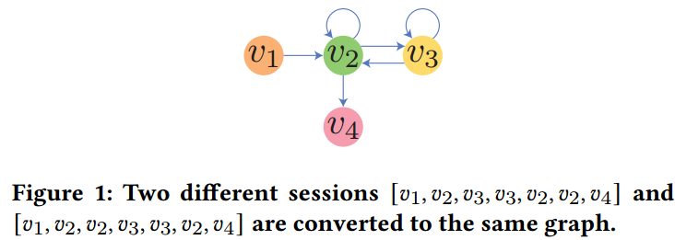
MOTIVATION
Lossy session encoding problem
Ineffective long-rang dependency capturing problem
For GNN model, each layer can capture only 1-hop relation, the optimal number of layers for the GNN models is usually no longer than 3, due to overfitting and over-smoothing problems. Thus, the model can only capture up to 3-hop relation.

Slide 3
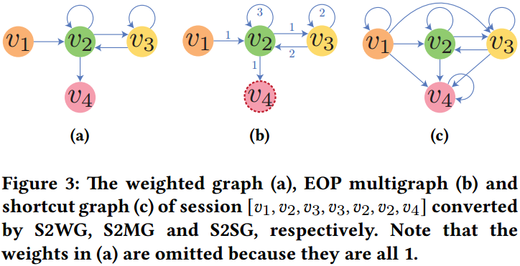
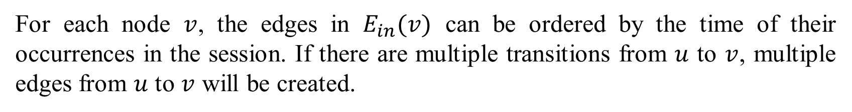
S2MG
S2MG:Session to EOP (edge-order preserving) Multigraph
For each node $v$, the edges in $E_{in}(v)$ can be ordered by the time of their occurrences in the session. If there are multiple transitions from $u$ to $v$, multiple edges from $u$ to $v$ will be created.

Slide 4
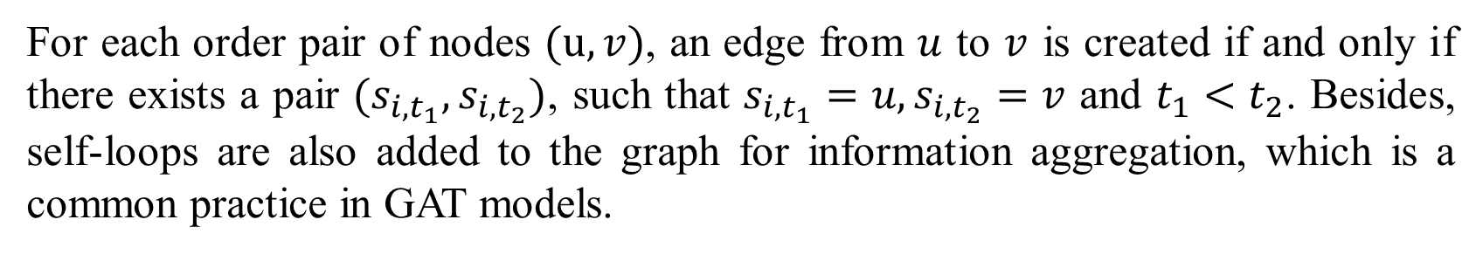
S2SG
S2MG:Session to Shortcut Graph
For each order pair of nodes $(u, v)$, an edge from $u$ to $v$ is created if and only if there exists a pair $(s_{i,t_{1}},s_{i,t_{2}})$, such that $s_{i,t_{1}}=u,s_{i,t_{2}}=v$ and $t_{1}<t_{2}$. Besides, self-loops are also added to the graph for information aggregation, which is a common practice in GAT models.

Slide 5
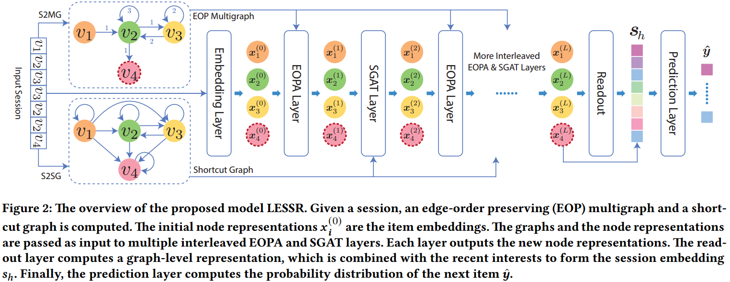
LESSR
LESSR: Lossless Edge-order preserving aggregation and Shortcut graph attention for Session-based Recommendation

Slide 6
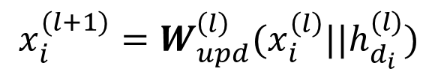
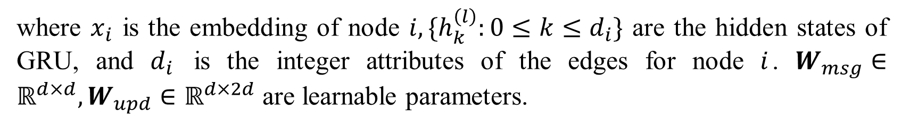

LESSR-EOPA (Edge-Order-Preserving Aggregation) Layer
Information update
$$x_{i}^{(l+1)}=W_{upd}^{\left(l\right)}(x_{i}^{\left(l\right)}||h_{d_{i}}^{(l)})$$
Message aggregation
$$h_{k}^{(l)}={GRU}^{\left(l\right)}(W_{msg}^{\left(l\right)}x_{jk}^{\left(l\right)},h_{k−1}^{(l)})$$
where $x_{i}$ is the embedding of node $i, \{h_{k}^{\left(l\right)}:0≤k≤d_{i}\}$ are the hidden states of GRU, and $d_{i}$ is the integer attributes of the edges for node $i$. $W_{msg}∈ℝ^{d×d},W_{upd}∈ℝ^{d×2d}$ are learnable parameters.

Slide 7
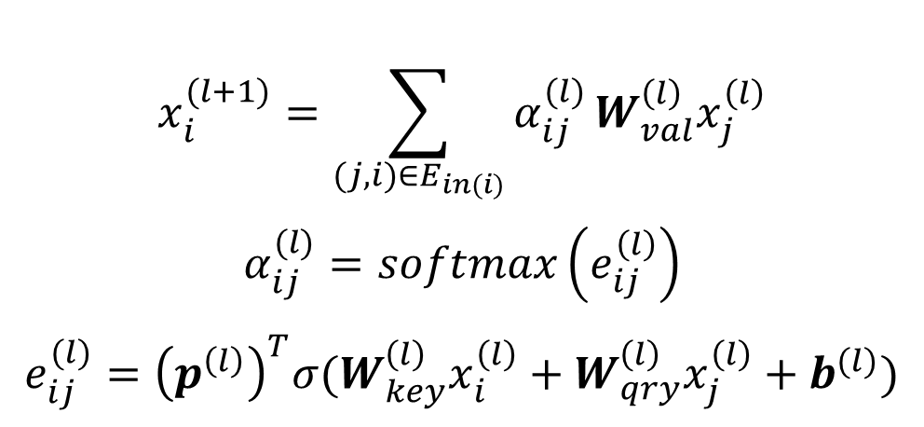
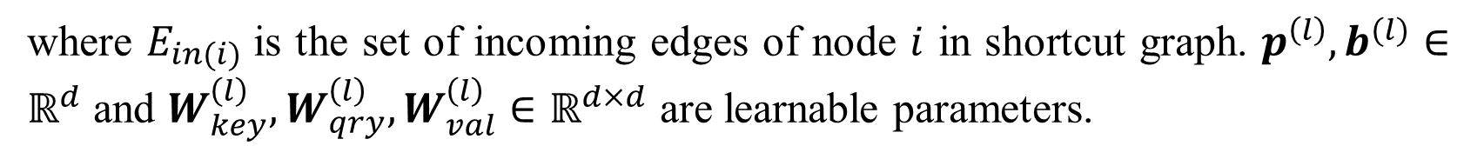
LESSR-SGAT (Shortcut Graph Attention) Layer
Information update
$$x_{i}^{(l+1)}=\sum_{(j,i)∈E_{in(i)}}{α_{ij}^{(l)}}W_{val}^{\left(l\right)}x_{j}^{\left(l\right)}$$
$$α_{ij}^{(l)}=softmax\left(e_{ij}^{\left(l\right)}\right)$$
$$e_{ij}^{(l)}={\left(p^{\left(l\right)}\right)}^{T}σ(W_{key}^{\left(l\right)}x_{i}^{\left(l\right)}+W_{qry}^{\left(l\right)}x_{j}^{\left(l\right)}+b^{(l)})$$
where $E_{in(i)}$is the set of incoming edges of node $i$ in shortcut graph. $p^{\left(l\right)},b^{(l)}∈ℝ^{d}$ and $W_{key}^{\left(l\right)},W_{qry}^{\left(l\right)},W_{val}^{\left(l\right)}∈ℝ^{d×d}$ are learnable parameters.

Slide 8
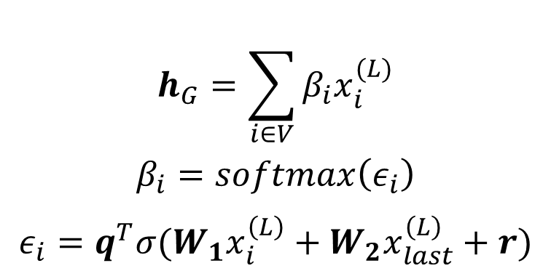
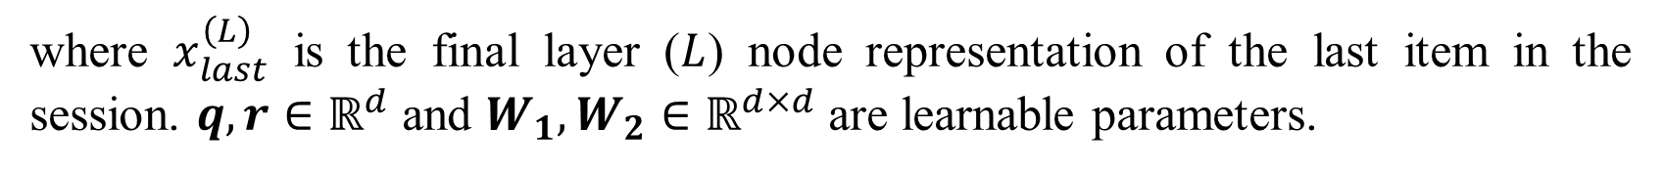


LESSR-Session Embedding
Graph-level representation
$$h_{G}=\sum_{i∈V}{β_{i}x_{i}^{(L)}}$$
$$β_{i}=softmax\left(ε_{i}\right)$$
$$ε_{i}=q^{T}σ(W_{1}x_{i}^{\left(L\right)}+W_{2}x_{last}^{\left(L\right)}+r)$$
where $x_{last}^{\left(L\right)}$ is the final layer ($L$) node representation of the last item in the session. $q,r∈ℝ^{d}$ and $W_{1},W_{2}∈ℝ^{d×d}$ are learnable parameters.
Local-level representation
$s_{l}=$ $x_{last}^{\left(L\right)}$
Session Embedding
$$s_{h}=W_{h}(s_{g}||s_{l})$$
where $s_{g}=h_{G}$, and $W_{h}∈ℝ^{d×2d}$ is learnable parameters.

Slide 9
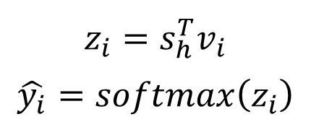

LESSR-Prediction Layer
Predicted probability of the next item
$$z_{i}=s_{h}^{T}v_{i}$$
$$\hat{y_{i}}=softmax\left(z_{i}\right)$$
where $\hat{y_{i}}$is the predicted probability of the next item $i$.
Loss function
$$ℒ\left(y,\hat{y}\right)=−y^{T}log\hat{y}$$

Slide 10
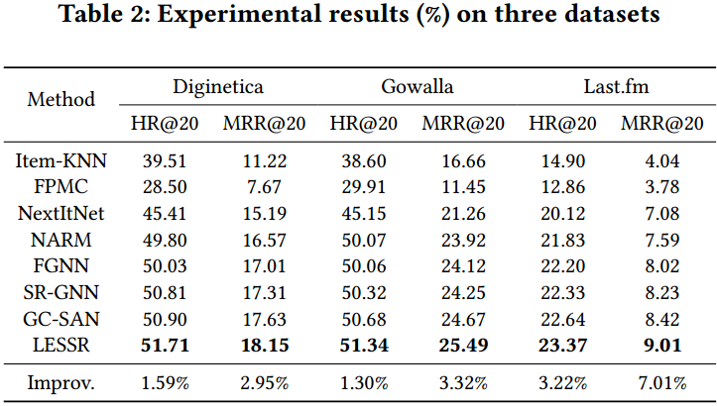
EXPERIMENTS

Slide 11
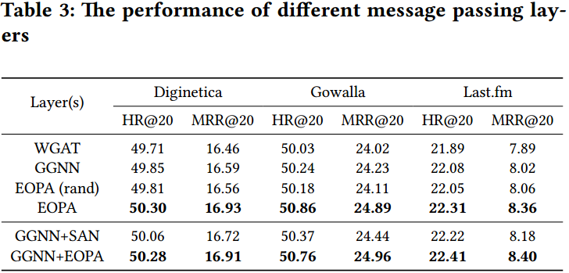
EXPERIMENTS

